Slide 1

Small Business Marketing Toolkit
Powered by Upnetic

Slide 2
Overview
Current Client & Sales Experience
Future Client & Sales Experience
When clients inquire about marketing services, there are only 2 options today:
  Upgrade to the HR Pro bundle
  Purchase a separate, standalone marketing suite with no integration capabilities
As both of these options are expensive, they may not be ideal for cost-sensitive clients.
By not offering an affordable and integrated solution, ADP may be missing the mark on potential sales and increased retention.
Where HR Pro is not feasible, Sales will inform clients of the option to purchase the Small Business Marketing Toolkit:
  Sales will provide clients with a feature overview over the phone.
  If the client is interested, Sales will submit a Sales order via ESO.
  Implementation/Sales HelpDesk will enable the Marketing Toolkit feature on the Payroll Features section in RUN.
  Lead generation opportunity for the HRBA team. Leads will submitted through normal channel to internal sales team.

Slide 3
Overview (cont.)
Sales Rules | Billing
Limited to clients with 1-4 EE’s Clients must be enrolled in Essential or Enhanced package Existing discounts will apply to Marketing Toolkit feature Marketing Toolkit discount should not exceed discount on payroll bundle / features | Book Price: $40 per client per month $40 Fee equally divided by pay frequency: Weekly $9.25 Bi-Weekly $18.50 Semi-Monthly $19.95 Monthly $40.00 Quarterly $120.00

Slide 4
Is
The Small Business Marketing Toolkit is a new add-on product available to new & existing clients enrolled in the Essential & Enhanced bundles with 1-4 EE’s for $40/mo.
    Website Builder: template-driven, free hosting/SSL, unlimited pages
    Digital Media Analyzer: action steps to improve website, social, SEO
    Google My Business Optimization: DIFM service for improving Google Maps & Search
    Dashboard: manage social media platforms & digital analytics from a single platform
    CRM: manage prospects and clients + integration with Mailchimp for email marketing
    Learning Lab: sales & marketing videos & articles
    One-on-One Coaching: scheduled sessions with marketing experts

Slide 5
Does
Helps small businesses establish and manage their online brand, improve search performance, and engage with customers.
Attract
Engage
Assess
Assess

Slide 6
Means
Clients will have the tools & guidance they need to attract more customers & increase their revenue.
    Huge HR Pro upgrade potential!
    Upnetic service offerings expand as the business expands.

Slide 7
Upnetic Feature Comparison Chart
Upnetic Features | Description | Marketing Toolkit Essential & Enhanced | Upnetic HR Pro
Google My Business Optimization | Enhance your local Google Search and Maps results by claiming and optimizing your profile with help from our team of certified experts. | ✓ | ✓
CRM with Email Marketing | Streamline your sales pipeline, store all your vital contact data, and create and send beautiful marketing emails through Mailchimp. | ✓ | ✓
Digital Marketing Analyzer | Identify key steps to improve your website and digital brand from our web experts. | ✓ | ✓
Learning Lab | Sharpen your skillset and get inspiration for growing your business in our library of sales & marketing focused videos & articles. | ✓ | ✓
Digital Media Dashboard | Make adjustments to your online brand based on real-time data and build your following by engaging followers through social media. | ✓ | ✓
Website Builder | Build a fully responsive website with pre-made templates, unlimited pages, free SSL certificate, and free hosting. | ✓ | ✓
BizPro Training Courses | Employer & Employee Training and Development platform with video courses on sensitive business matters and fundamental business practices. BizPro is available in the ADP® HR Pro bundle, or as a stand-alone app on ADP Marketplace. | ✗ | ✓
Small Business Consultation | Have confidence in your decision making by asking any question, any time, and getting unlimited answers from our expert business consultants. | ✗ | ✓
Legal Services | Get connected to a qualified attorney in your area to help with your business’s legal issues, including select services provided free. | ✗ | ✓
Business Plan Software | Secure funding and guide your business more effectively through a modern business plan, complete with financial statements and projections. | ✗ | ✓
Business Roadmap Assessment | Identify action steps for key areas of your business with specific insights based on a customized analysis of your business. | ✗ | ✓

Slide 8

Client Access
SSO through RUN > Exclusive Benefits:
Marketing Toolkit
Digital Onboarding Consultant
First Login
Website Builder + Audit
Search + Social Media Tools
CRM + Email Marketing
First login
Returning Login
Upnetic Homepage
Open

Slide 9
Digital Onboarding Consultant
Client provides:
Industry
Number of Employees
Entity & Business Type
State
Website URL
GMB/Social
CRM
Client schedules Marketing Consultation
Client enters Upnetic
Client receives Website & Digital Marketing Analysis report

Slide 10
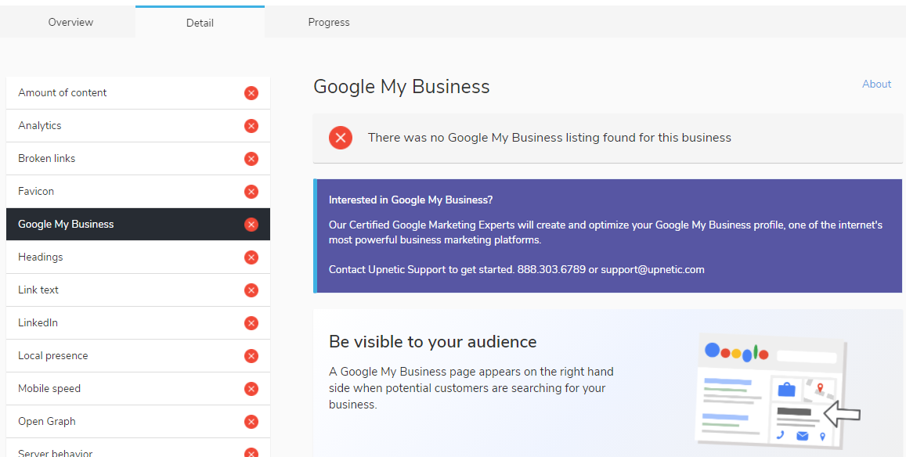
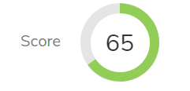
Digital Marketing Analyzer
Multi-point optimization analysis
Detailed instructional report within account
1-on-1 consultations available

Slide 11
Website Builder Features
Unlimited pages
Blog & multimedia capabilities
Pre-designed templates
Mobile & tablet optimized
Google Analytics integration
CRM contact form integration
Included Cost Savings:
Free SSL Certificate ($65/yr average cost)
Free Hosting & subdomain ($80/mo average cost)
One-on-one consultations w/web experts
+ Upgrades:
Custom domain options ($10/yr)
eCommerce capabilities ($9.95/mo)
According to the SBA, of the 30 million businesses in the U.S., only 64% of small businesses have a website.

Slide 12
Website Builder Benefits
Hosting
US: Upnetic provides Dedicated WordPress hosting:
    Average cost: $80/month
    Smooth scaling for traffic spikes
    Global CDN (fast load times)
    Full page caching (fast load times)
THEM: Shared hosting (most common for basic websites):
    Average cost: $8.75/mo
    Causes slow load times, security risks
SSL Certificates
An SSL certificate ensures that the website is safe and secure from cyber-attacks (https)
  Sites with SSls are ranked higher by Google & trusted more by visitors
Upnetic provides DV Certificates (most common)
Average cost: $64.99/yr
Upnetic manages renewals (GoDaddy charges extra)

Slide 13

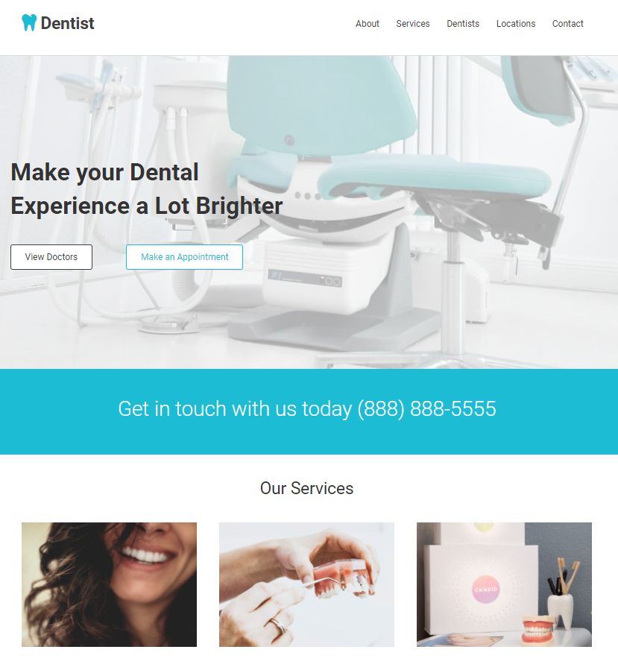
Website Templates
Top Industries for Enhanced/
Essentials bundles:
Restaurants
Legal
Doctor
Dentist
Auto Repair
Consulting
Building Equipment
Insurance
Day Care
Tax/payroll
View templates: https://upneticsite.com/?template-preview=68

Slide 14
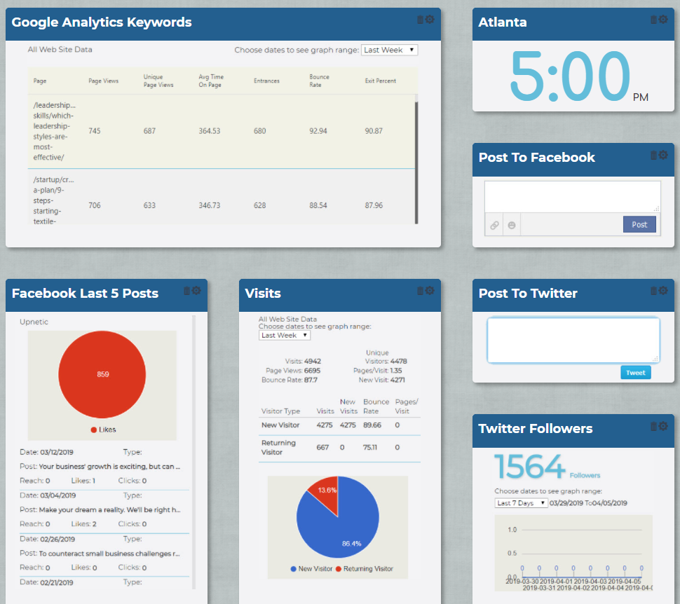
Digital Media Dashboard
Social media integration
Google Analytics integration
Customizable dashboard

Slide 15
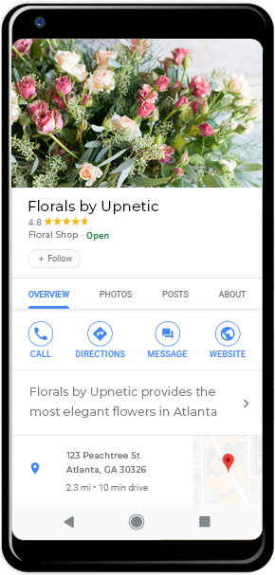
Google My Business Optimization
DIFM creation & optimization service
Enhance local search & maps
1-on-1 consultations available
93% of customers say that their buying decisions are influenced by online reviews.
Upnetic can help clients manage and respond to customer reviews.

Slide 16
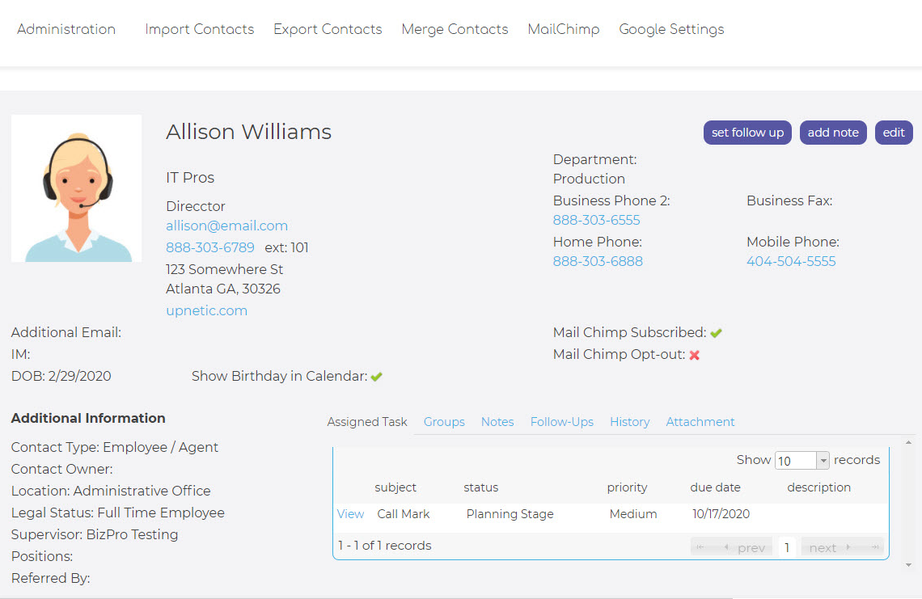

CRM
Track sales leads
Store & leverage prospect & customer data
Mailchimp® email marketing integration

Slide 17
Qualifying Questions
When customers look for you online or on Google Maps, what do they see?
How do you monitor your website and social performance?
How much do you spend on website and hosting services?
Who do you consult with on important marketing questions and decisions?
What are you currently doing to convert prospects to customers?

Slide 18
Competition: Freshlime via Paychex
Paychex Offer: Get 12-months of the Local Launch Platform to help promote your business on the web; receive an online business performance report + $1,000 in prepaid digital marketing services
Feature | Small Business Marketing Toolkit $40/mo | Freshlime SEO Package $149 startup + $49.99/mo | Freshlime Website Package $49.99/mo
GMB Optimization | ✓ | ✓ | ✗
CRM | ✓ | ✓ | ✗
Digital Marketing Dashboard | ✓ | ✓ | ✗
Digital Marketing Analysis | ✓ | ✓ | ✗
Website Builder | DIY: unlimited pages | ✗ | DIFM: 1-3 pages

Slide 19
Competitive Advantage
Price: low monthly cost, no start-up fees
Capabilities: more tools, integrations, all-in-one suite, SSO
Service: white glove service including full digital marketing analysis, one-on-one consultations, do-it-for-me GMB
Scaling: features expand as business expands

Slide 20
Recap
Small Business Marketing Toolkit
Add-on product available to new & existing clients enrolled in the Essential & Enhanced bundles with 1-4 EE’s for $40/mo
Helps small businesses establish and manage their online brand, improve search performance, and engage with customers.
Clients will have the tools & guidance they need to attract more customers & increase their revenue.
  Website Builder
  Digital Media Analyzer
  GMB Optimization
  Dashboard
  CRM
  Learning Lab
  One-on-One Coaching
Demo: tkdemo.upnetic.com
Info: upnetic.com/toolkit

Slide 21
Questions

