Slide 1


Notes:
BizPro provides online employer & employee training that helps create a safer work environment, improve corporate culture, and drive growth.

Slide 2
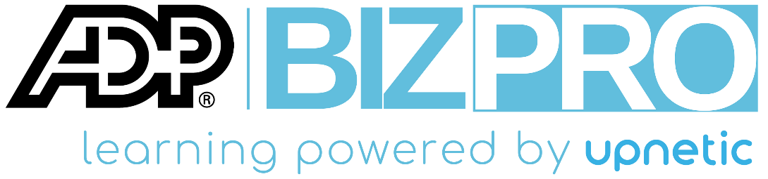
+400k
employees trained
86%
sexual harassment prevention training
sexual harassment
workplace harassment
safety training

Slide 3

State Mandates
State | Deadline | Renewal
New York State | 10/9/2019 | Annually
New York City | 12/31/2019 | Annually
Illinois | 12/31/2020 | Annually
California | 1/1/2021 | Every 2 years
Connecticut | 5/20/2021 | Every 10 years
pro.upnetic.com/state-requirements
Notes:
The states listed above require by law that employers provide sexual harassment prevention training to their employees. BizPro’s courses comply with each state’s guidelines. Click on the link above to learn more about requirements for each state.

Slide 4


Sexual Harassment Prevention Training & More
marketplace offering:
$49/month for up to 10 employees
$69/month: 11-49 employees
$99/month: 50-100 employees

Slide 5
About
Educate and empower your entire company with a wide selection of video-based training courses
Features
State-compliant sexual harassment prevention trainings for CA, CT, IL, NY, and NYC
Completion certifications & auto-renewal reminders
Administrator & employee accounts
Seats up to 100 users per company
SHRM courses for reaccreditation
Benefits
Optimize employee training
Implement HR best practices
Reduce training costs
Improve employee skills & productivity
Attract & retain talent
Notes:
Most competitors offer training per seat annually. BizPro’s subscription model prevents unpredictable billing with one subscription for the entire company!

Slide 6
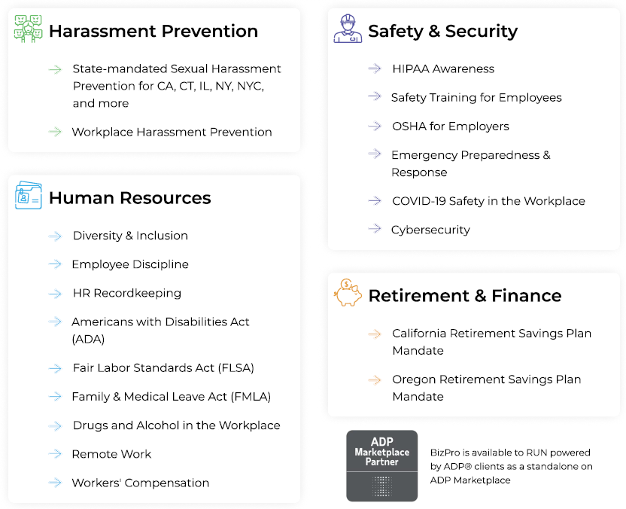
Courses

Slide 7
Resources
Marketing video: vimeopro.com/tarkenton/bizpro-video
Course list: pro.upnetic.com
State requirements: pro.upnetic.com/state-requirements
SBS Sales resource page: sbs.upnetic.com

